Slide 1
DSC40B: Theoretical Foundations of Data Science II
Lecture 3: More on asymptotic time complexity; Best and Worst case
Instructor: Yusu Wang

Slide 2
Today
More on asymptotic complexity
Properties, and some cautioning
Asymptotic time complexity of algorithms
Best time? Worst time? Expected time?

Slide 3
More about Asymptotic complexity

Slide 4
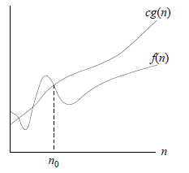
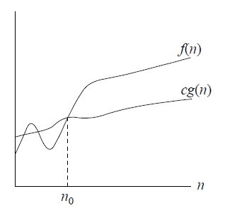
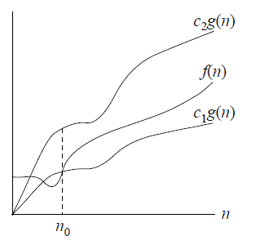
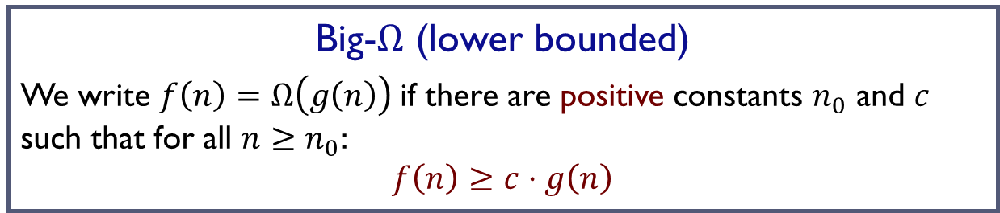
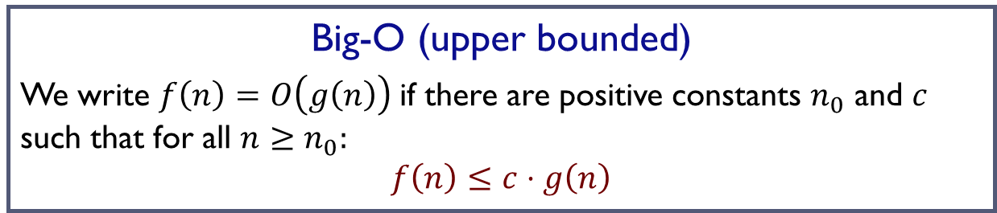
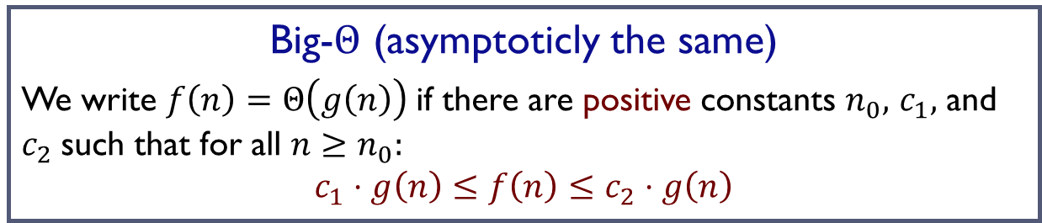
Previously,
Big-O (upper bounded)
We write $f\left(n\right)=O\left(g\left(n\right)\right)$if there are positive constants $n_{0}$ and $c$ such that for all $n≥n_{0}:$
$$f\left(n\right)≤c⋅g\left(n\right)$$
Big-$Ω$ (lower bounded)
We write $f\left(n\right)=Ω\left(g\left(n\right)\right)$if there are positive constants $n_{0}$ and $c$ such that for all $n≥n_{0}:$
$$f\left(n\right)≥c⋅g\left(n\right)$$
Big-$Θ$ (asymptoticly the same)
We write $f\left(n\right)=Θ\left(g\left(n\right)\right)$if there are positive constants $n_{0},$ $c_{1},$ and $c_{2}$such that for all $n≥n_{0}:$
$$c_{1}⋅g\left(n\right)≤f\left(n\right)≤c_{2}⋅g\left(n\right)$$

Slide 5
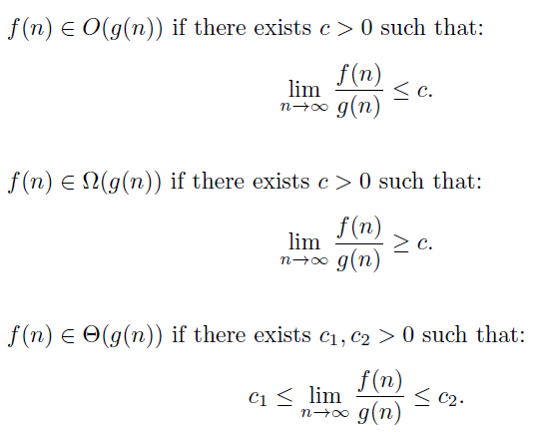

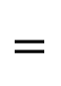

Another view
Assume that $\lim_{n→∞}{\frac{f(n)}{g\left(n\right)}}$ exists.
$$=$$
$$=$$
$$=$$

Slide 6
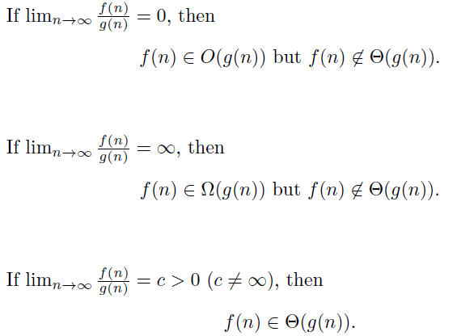
Useful special cases

Slide 7
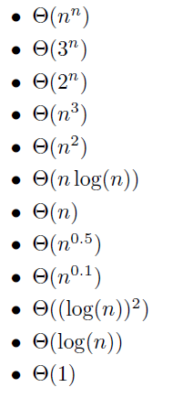
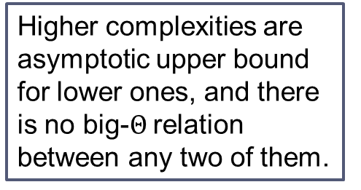
Hierarchy
Higher complexities are asymptotic upper bound for lower ones, and there is no big-$Θ$ relation between any two of them.
Complexity decreasing

Slide 8

Some more examples
$n \sqrt{n}=O\left(n^{2}\right)$ ?
$\lg{n =O\left(n\right)}$?
$\lg{n= }O\left(\sqrt{n}\right) ?$
$n lg{n=O}\left(n^{1.5 }\right) ?$
$3 n^{2} −n\sqrt{n}+n\lg{n }=Θ($___) ?
${10}^{10} n=O\left(n^{2}\right) ?$

Slide 9
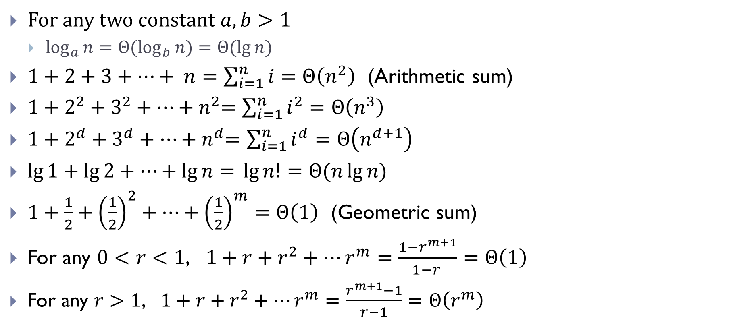
Some useful relations
For any two constant $a, b>1$
$\log_{a}{n=Θ(\log_{b}{n)=Θ(\lg{n) } }}$
$1+2+3+⋯+ n=\sum_{i=1}^{n}{i}=Θ\left(n^{2}\right)$ (Arithmetic sum)
$1+2^{2}+3^{2}+⋯{+ n}^{2}=\sum_{i=1}^{n}{i^{2}}=Θ\left(n^{3}\right)$
$1+2^{d}+3^{d}+⋯{+ n}^{d}=\sum_{i=1}^{n}{i^{d}}=Θ\left(n^{d+1}\right)$
$\lg{1+\lg{2+⋯+\lg{n= }}}\lg{n!}=Θ(n\lg{n)}$
$1+\frac{1}{2}+{\left(\frac{1}{2}\right)}^{2}+⋯+{\left(\frac{1}{2}\right)}^{m}=Θ\left(1\right)$ (Geometric sum)
For any $0<r<1$, $1+r+r^{2}+⋯r^{m}=\frac{1−r^{m+1}}{1−r }=Θ\left(1\right)$
For any $r>1$, $1+r+r^{2}+⋯r^{m}=\frac{r^{m+1}−1}{r−1}=Θ\left(r^{m}\right)$

Slide 10
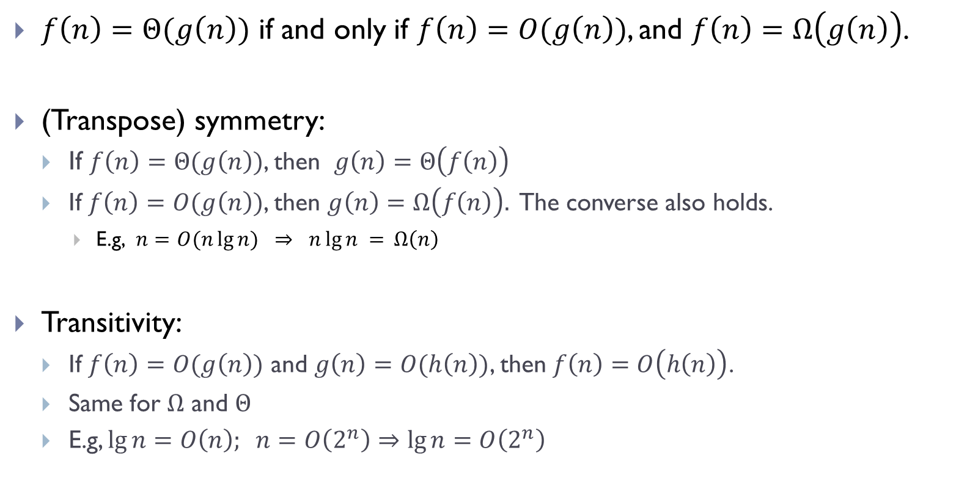
Properties
$f\left(n\right)=Θ(g\left(n\right))$ if and only if $f\left(n\right)=O(g\left(n\right))$, and $f\left(n\right)=Ω\left(g\left(n\right)\right)$.
(Transpose) symmetry:
If $f\left(n\right)=Θ(g\left(n\right))$, then $g\left(n\right)=Θ\left(f\left(n\right)\right)$
If $f\left(n\right)=O(g\left(n\right))$, then $g\left(n\right)=Ω\left(f\left(n\right)\right).$ The converse also holds.
E.g, $n=O(n\lg{n) }⇒ n\lg{n = }Ω\left(n\right)$
Transitivity:
If $f\left(n\right)=O(g\left(n\right))$ and $g\left(n\right)=O(h\left(n\right))$, then $f\left(n\right)=O\left(h\left(n\right)\right)$.
Same for $Ω$ and $Θ$
E.g, $\lg{n=O\left(n\right); } n=O\left(2^{n}\right)⇒\lg{n=O\left(2^{n}\right) }$

Slide 11
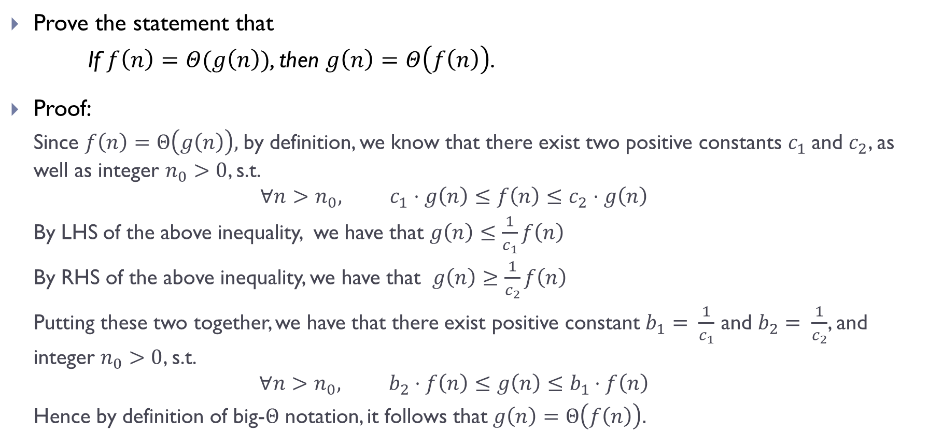
Prove the statement that
If $f\left(n\right)=Θ(g\left(n\right))$, then $g\left(n\right)=Θ\left(f\left(n\right)\right)$.
Proof:
Since $f\left(n\right)=Θ\left(g\left(n\right)\right),$by definition, we know that there exist two positive constants $c_{1}$and $c_{2}$, as well as integer $n_{0}>0$, s.t.
$${∀n>n_{0}, c}_{1}⋅g\left(n\right)≤f\left(n\right)≤c_{2}⋅g\left(n\right)$$
By LHS of the above inequality, we have that $g\left(n\right)≤\frac{1}{c_{1}}f\left(n\right)$
By RHS of the above inequality, we have that $g\left(n\right)≥\frac{1}{c_{2}}f\left(n\right)$
Putting these two together, we have that there exist positive constant $b_{1}= \frac{1}{c_{1}}$ and $b_{2}= \frac{1}{c_{2}}$, and integer $n_{0}>0$, s.t.
$${∀n>n_{0}, b}_{2}⋅f\left(n\right)≤g\left(n\right)≤b_{1}⋅f\left(n\right)$$
Hence by definition of big-$Θ$ notation, it follows that $g\left(n\right)=Θ\left(f\left(n\right)\right).$

Slide 12
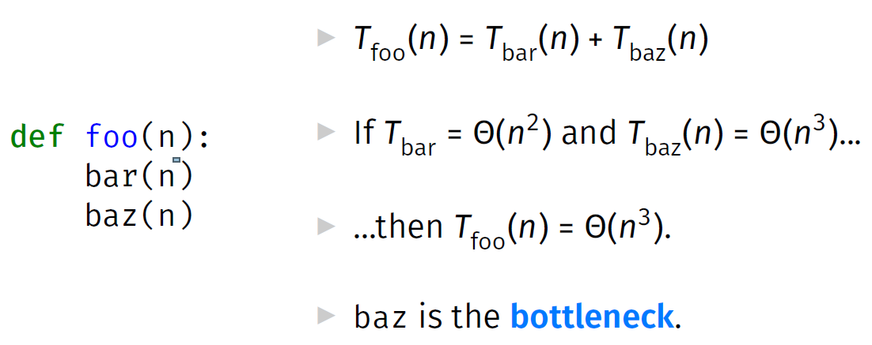
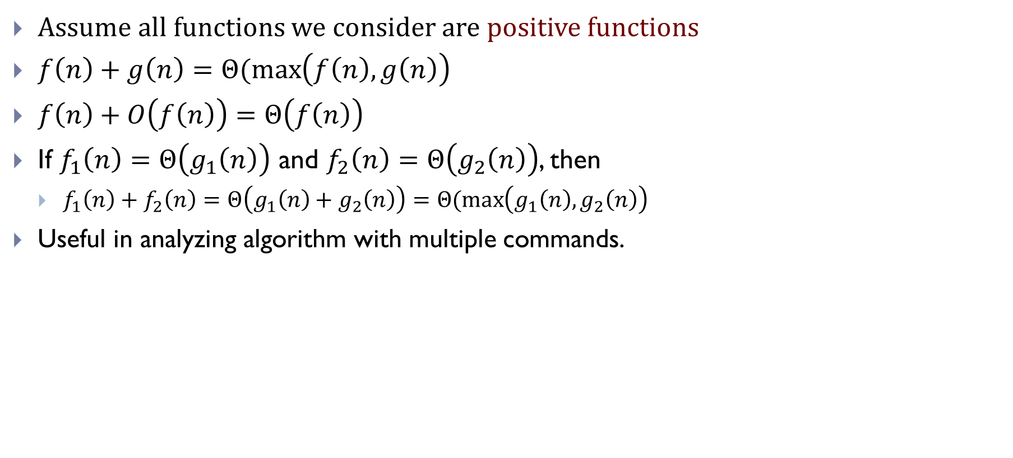
Properties
Assume all functions we consider are positive functions
$f\left(n\right)+g\left(n\right)=Θ(\max\left(f\left(n\right), g\left(n\right)\right)$
$f\left(n\right)+O\left(f\left(n\right)\right)=Θ\left(f\left(n\right)\right)$
If $f_{1}\left(n\right)=Θ\left(g_{1}\left(n\right)\right)$ and $f_{2}\left(n\right)=Θ\left(g_{2}\left(n\right)\right)$, then
$f_{1}\left(n\right)+f_{2}\left(n\right)=Θ\left(g_{1}\left(n\right)+g_{2}\left(n\right)\right)=Θ(\max\left(g_{1}\left(n\right), g_{2}\left(n\right)\right)$
Useful in analyzing algorithm with multiple commands.

Slide 13
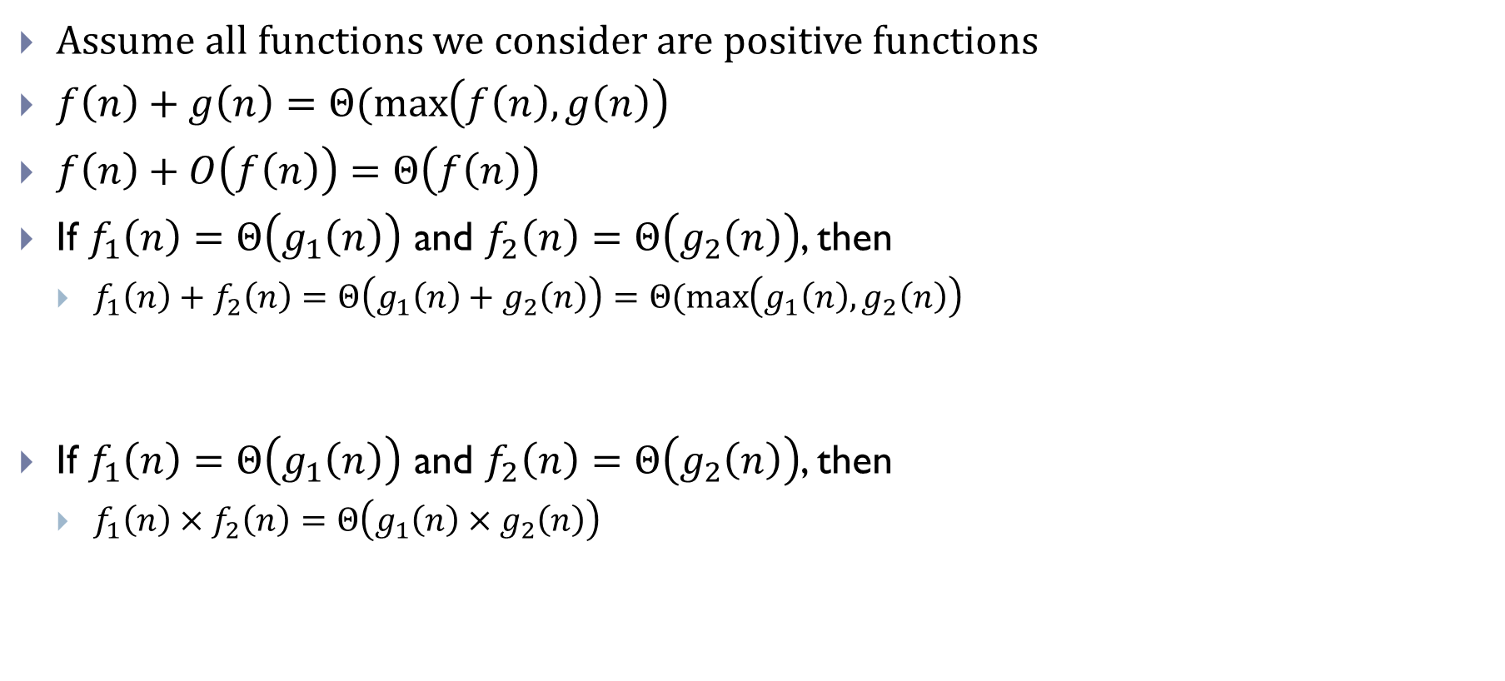
Properties
Assume all functions we consider are positive functions
$f\left(n\right)+g\left(n\right)=Θ(\max\left(f\left(n\right), g\left(n\right)\right)$
$f\left(n\right)+O\left(f\left(n\right)\right)=Θ\left(f\left(n\right)\right)$
If $f_{1}\left(n\right)=Θ\left(g_{1}\left(n\right)\right)$ and $f_{2}\left(n\right)=Θ\left(g_{2}\left(n\right)\right)$, then
$f_{1}\left(n\right)+f_{2}\left(n\right)=Θ\left(g_{1}\left(n\right)+g_{2}\left(n\right)\right)=Θ(\max\left(g_{1}\left(n\right), g_{2}\left(n\right)\right)$
If $f_{1}\left(n\right)=Θ\left(g_{1}\left(n\right)\right)$ and $f_{2}\left(n\right)=Θ\left(g_{2}\left(n\right)\right)$, then
$f_{1}\left(n\right)×f_{2}\left(n\right)=Θ\left(g_{1}\left(n\right)×g_{2}\left(n\right)\right)$

Slide 14
Example
def foo(n):
for i in range(4*n + 4, 4*n**2 + 5):
for j in range(100*n, n**2):
print(i, j)

Slide 15
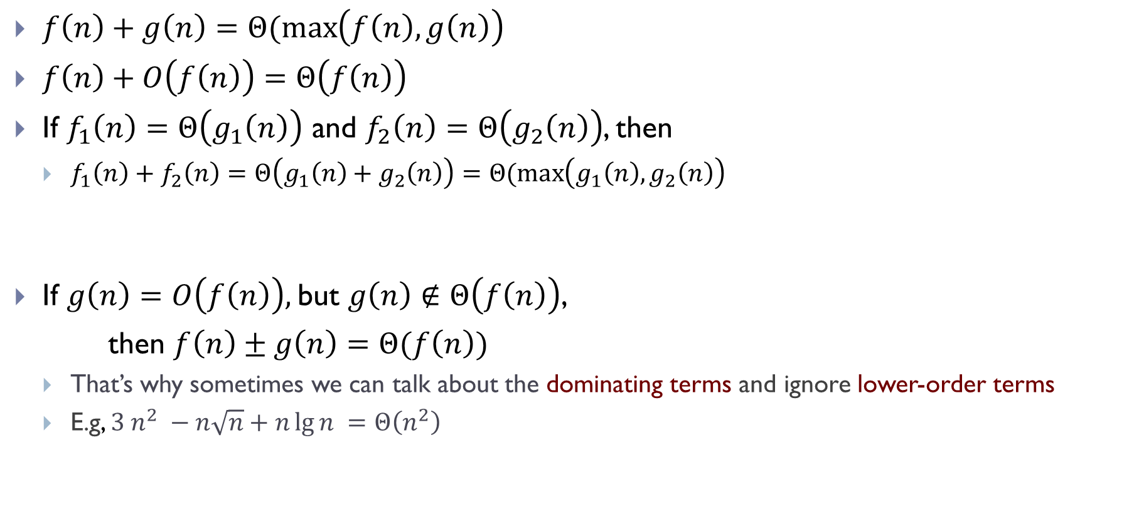
Properties
$f\left(n\right)+g\left(n\right)=Θ(\max\left(f\left(n\right), g\left(n\right)\right)$
$f\left(n\right)+O\left(f\left(n\right)\right)=Θ\left(f\left(n\right)\right)$
If $f_{1}\left(n\right)=Θ\left(g_{1}\left(n\right)\right)$ and $f_{2}\left(n\right)=Θ\left(g_{2}\left(n\right)\right)$, then
$f_{1}\left(n\right)+f_{2}\left(n\right)=Θ\left(g_{1}\left(n\right)+g_{2}\left(n\right)\right)=Θ(\max\left(g_{1}\left(n\right), g_{2}\left(n\right)\right)$
If $g\left(n\right)=O\left(f\left(n\right)\right),$but $g\left(n\right)∉Θ\left(f\left(n\right)\right)$,
then $f\left(n\right)±g\left(n\right)=Θ(f\left(n\right))$
That’s why sometimes we can talk about the dominating terms and ignore lower-order terms
E.g, $3 n^{2} −n\sqrt{n}+n\lg{n }=Θ\left(n^{2}\right)$

Slide 16
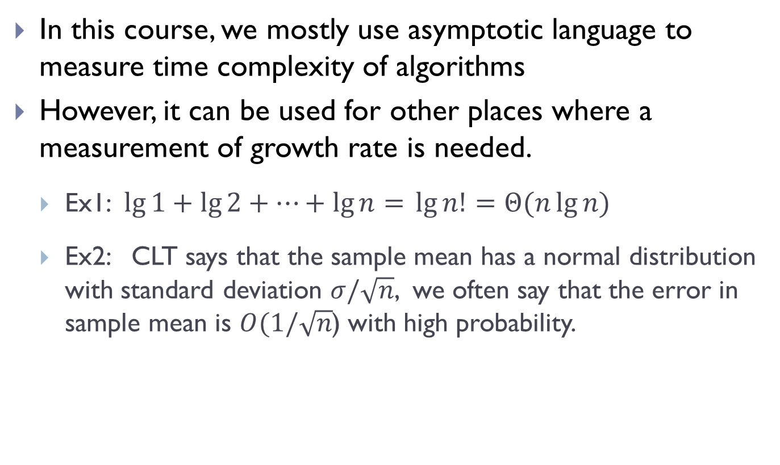
Remark 1:
In this course, we mostly use asymptotic language to measure time complexity of algorithms
However, it can be used for other places where a measurement of growth rate is needed.
Ex1: $\lg{1+\lg{2+⋯+\lg{n= }}}\lg{n!}=Θ(n\lg{n)}$
Ex2: CLT says that the sample mean has a normal distribution with standard deviation $σ/\sqrt{n}$, we often say that the error in sample mean is $O(1/\sqrt{n}$) with high probability.

Slide 17

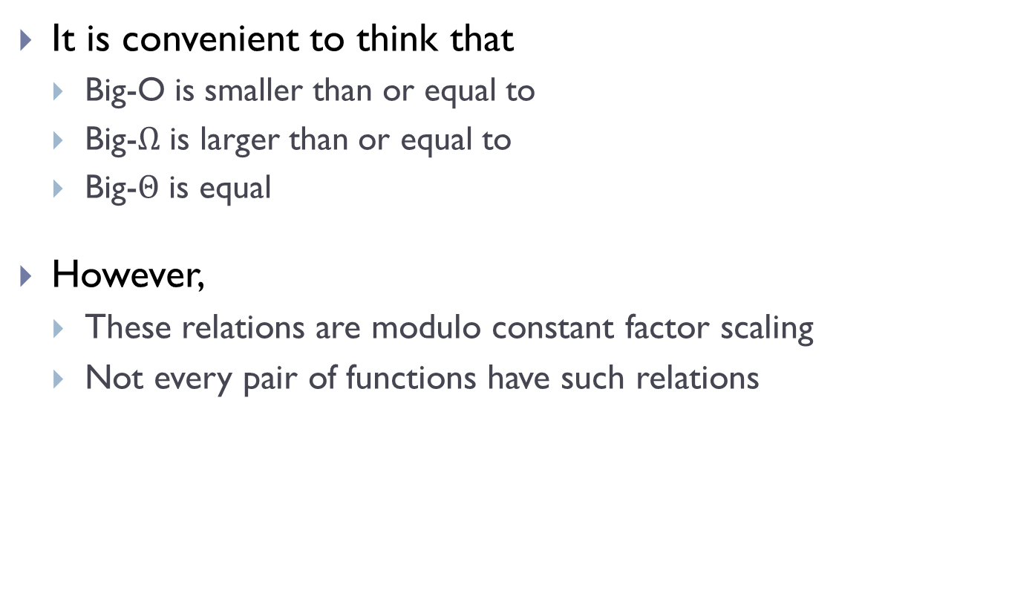
Caution 1:
It is convenient to think that
Big-O is smaller than or equal to
Big-$Ω$ is larger than or equal to
Big-$Θ$ is equal
However,
These relations are modulo constant factor scaling
Not every pair of functions have such relations
If $f\left(n\right)∉O(g\left(n\right))$, this does not imply that $f\left(n\right)=Ω(g\left(n\right))$.

Slide 18
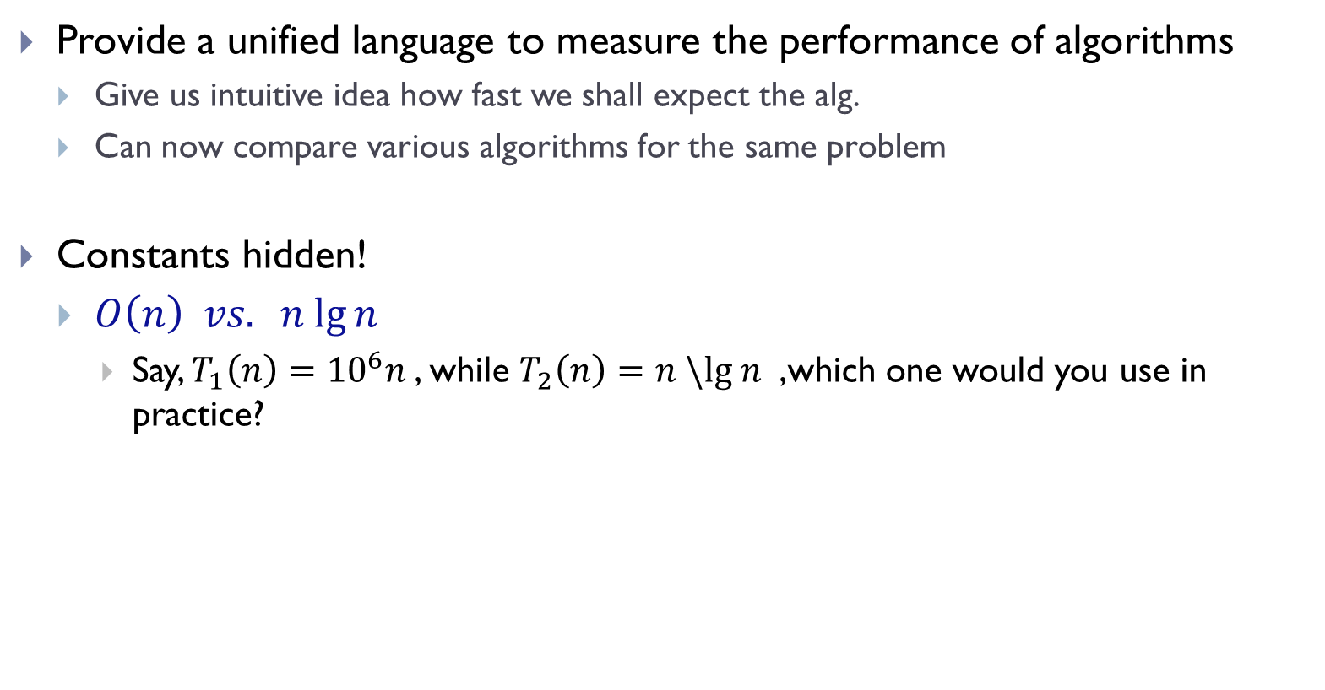
Caution 2
Provide a unified language to measure the performance of algorithms
Give us intuitive idea how fast we shall expect the alg.
Can now compare various algorithms for the same problem
Constants hidden!
$O\left(n\right) vs. n lg⁡n$
Say, $T_{1}\left(n\right)={10}^{6}n$, while $T_{2}\left(n\right)=n \backslash lg n$ ,which one would you use in practice?

Slide 19
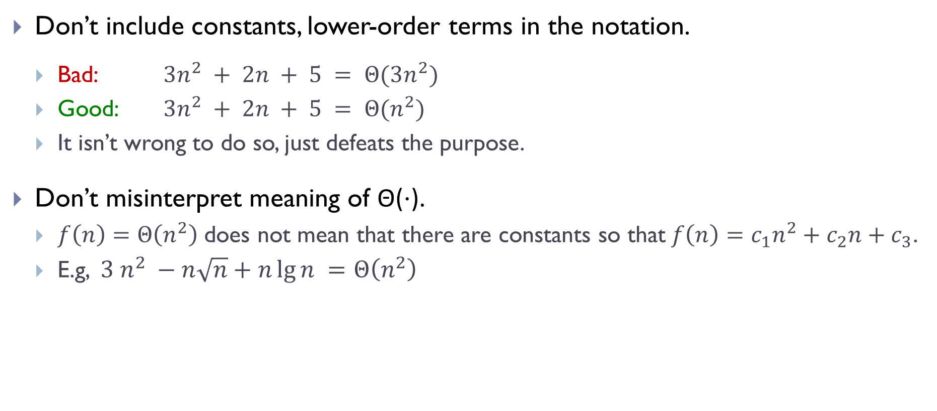
Caution 3
Don’t include constants, lower-order terms in the notation.
Bad: $3n^{2} + 2n + 5 = Θ(3n^{2})$
Good: $3n^{2} + 2n + 5 = Θ(n^{2})$
It isn’t wrong to do so, just defeats the purpose.
Don’t misinterpret meaning of Θ(⋅).
$f\left(n\right)=Θ\left(n^{2}\right)$does not mean that there are constants so that$f\left(n\right)=c_{1}n^{2}+c_{2}n+c_{3}$.
E.g, $3 n^{2} −n\sqrt{n}+n\lg{n }=Θ\left(n^{2}\right)$

Slide 20

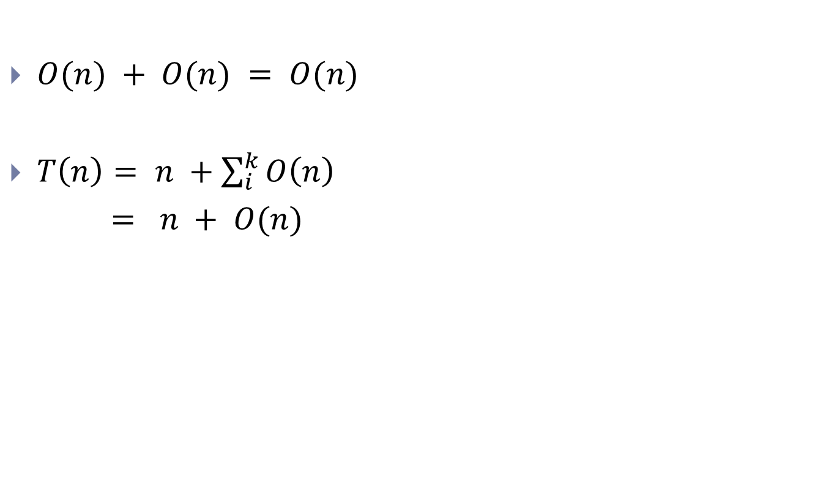
Caution 4
$O(n) + O(n) = O(n)$
$T\left(n\right)= n +\sum_{i}^{k}{O\left(n\right)}$
$= n + O(n)$
OK
?
$k$ should not depend on $n$ !
It has to be a constant …

Slide 21
Best time complexity, worst time complexity ?

Slide 22
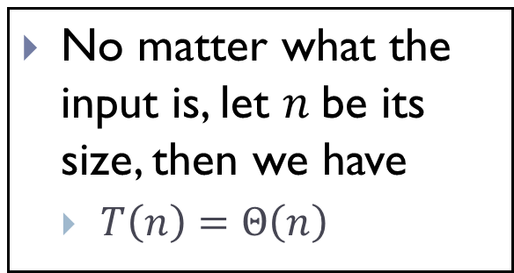
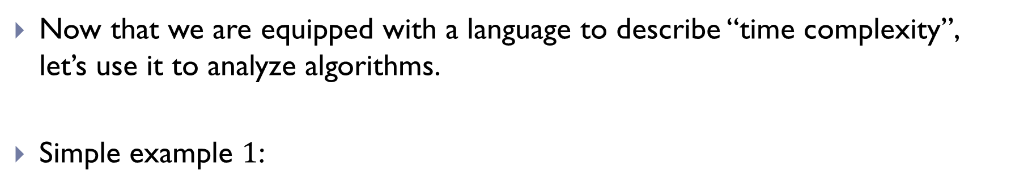
Now that we are equipped with a language to describe “time complexity”, let’s use it to analyze algorithms.
Simple example $1$:
def mean(arr):
total = 0
for x in arr:
total += x
return total / len(arr)
No matter what the input is, let $n$be its size, then we have
$T\left(n\right)=Θ\left(n\right)$

Slide 23
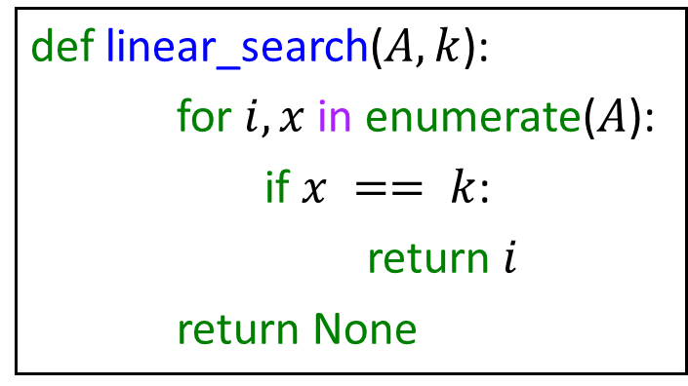
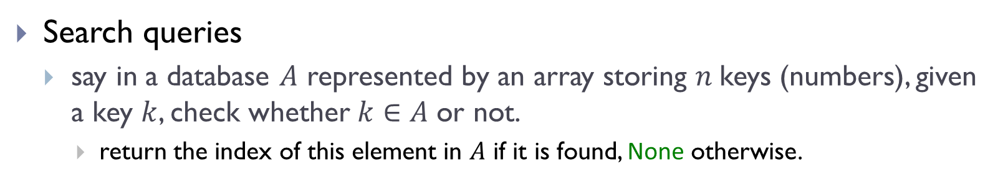
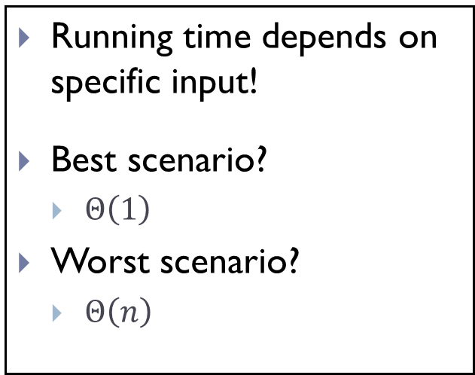
Simple Example 2
Search queries
say in a database $A$ represented by an array storing $n$keys (numbers), given a key $k$, check whether$k∈A$ or not.
return the index of this element in $A$ if it is found, None otherwise.
Running time depends on specific input!
Best scenario?
$Θ\left(1\right)$
Worst scenario?
$Θ\left(n\right)$
def linear_search($A, k$):
for $i, x$in enumerate($A$):
if $x == k$:
return $i$
return None

Slide 24
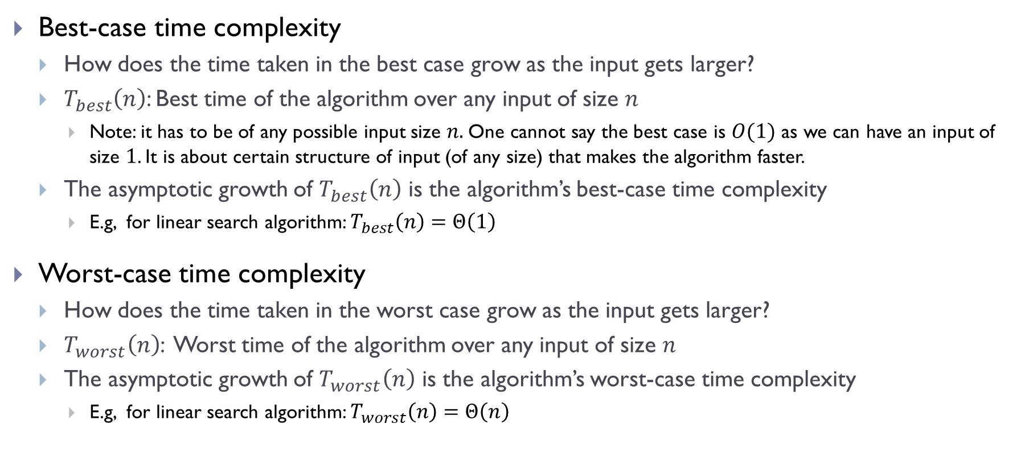
Best-case time complexity
How does the time taken in the best case grow as the input gets larger?
$T_{best}\left(n\right)$: Best time of the algorithm over any input of size $n$
Note: it has to be of any possible input size $n.$One cannot say the best case is $O(1)$ as we can have an input of size $1$. It is about certain structure of input (of any size) that makes the algorithm faster.
The asymptotic growth of $T_{best}\left(n\right)$ is the algorithm’s best-case time complexity
E.g, for linear search algorithm: $T_{best}\left(n\right)=Θ\left(1\right)$
Worst-case time complexity
How does the time taken in the worst case grow as the input gets larger?
$T_{worst}\left(n\right)$: Worst time of the algorithm over any input of size $n$
The asymptotic growth of $T_{worst}\left(n\right)$ is the algorithm’s worst-case time complexity
E.g, for linear search algorithm: $T_{worst}\left(n\right)=Θ\left(n\right)$

Slide 25
Often in practice (and in this class)
We focus on worst-case time complexity
So that we have confidence that even in the worst scenario, the time complexity will still be bounded by a certain value.
In data analysis
Average (expected) case is also important (see next time)
However, one should be mindful of the existence of the best-case time complexity, and understand that the running time can really depend on the specific input.

Slide 26
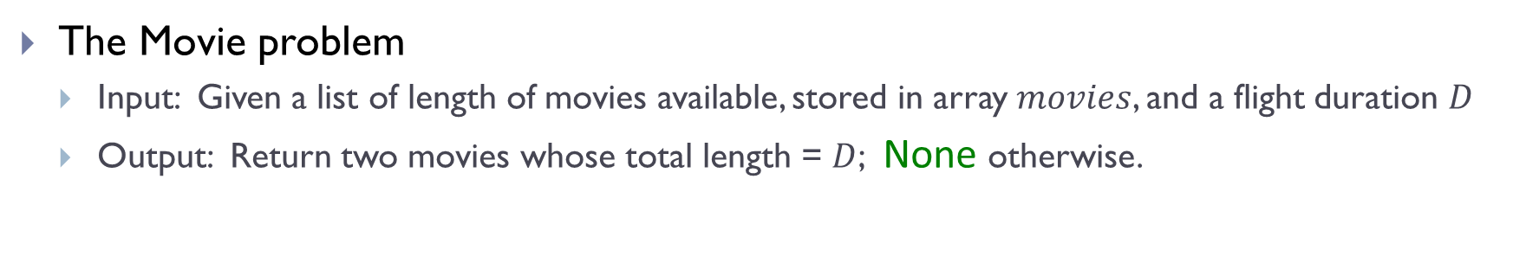
Another example
The Movie problem
Input: Given a list of length of movies available, stored in array $movies$, and a flight duration $D$
Output: Return two movies whose total length = $D$; None otherwise.

Slide 27

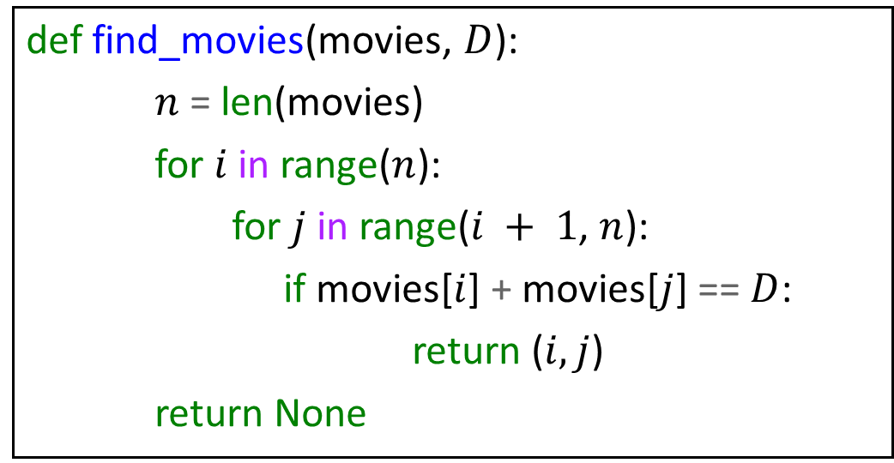
A simple approach
def find_movies(movies, $D$):
$n$ = len(movies)
for $i$ in range($n$):
for $j$ in range($i + 1$, $n$):
if movies[$i$] + movies[$j$] == $D$:
return ($i, j$)
return None
Best-case time complexity
$T_{best}\left(n\right)=Θ\left(1\right)$
Worst-case time complexity
$T_{worst}\left(n\right)=Θ\left(n^{2}\right)$

Slide 28
Exercise:
Can you find an algorithm with better worst-case time complexity ?

Slide 29
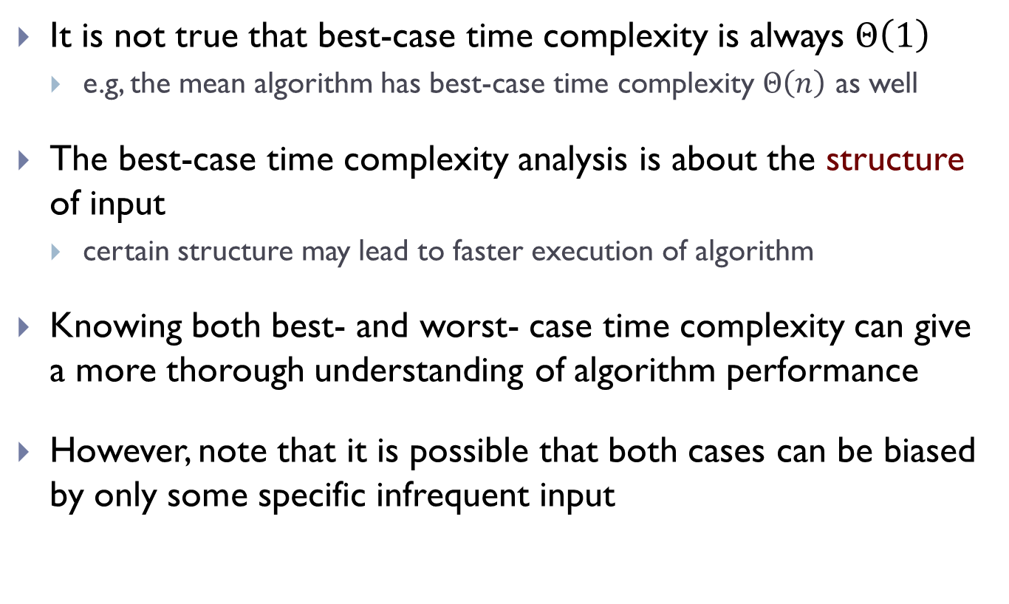
Remark
It is not true that best-case time complexity is always $Θ\left(1\right)$
e.g, the mean algorithm has best-case time complexity $Θ\left(n\right)$ as well
The best-case time complexity analysis is about the structure of input
certain structure may lead to faster execution of algorithm
Knowing both best- and worst- case time complexity can give a more thorough understanding of algorithm performance
However, note that it is possible that both cases can be biased by only some specific infrequent input

Slide 30
Next time
We will also talk about the average and expected running time
However, we again emphasize that in practice, the worst-case time analysis is the most common one, and also the one that we will use later in the course.

Slide 31
FIN

